Slide 1
02. Dynamic Programming (1)
Design and Analysis of Algorithm (DAA) 2
2016/2017
Abdul Munif

Slide 2
Agenda
Example Case: Cut Rod/Rod Cutting
Overlapping sub problems
Recurrence
Pseudocode → implementation

Slide 3
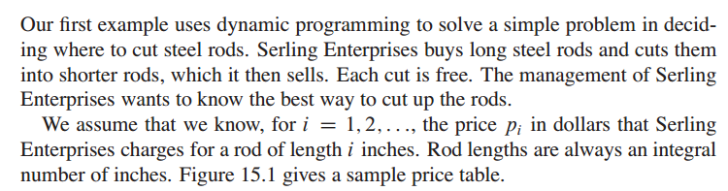
Problem Definition

Slide 4
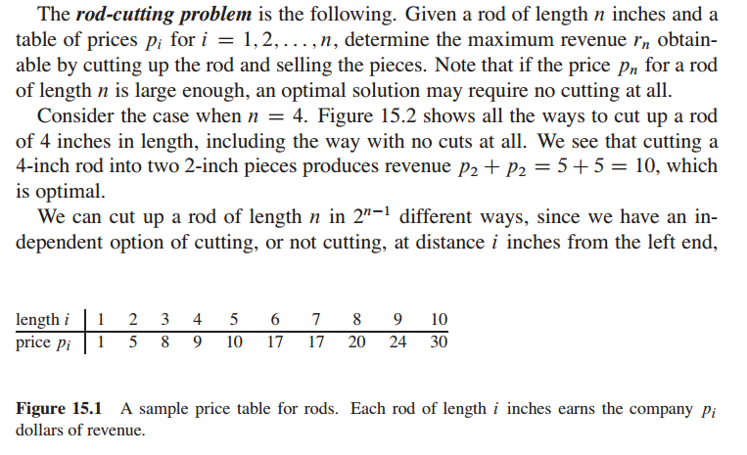
Problem Definition

Slide 5
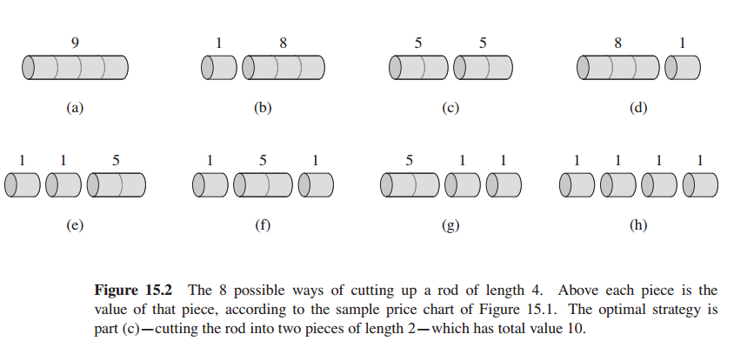
Problem Definition

Slide 6
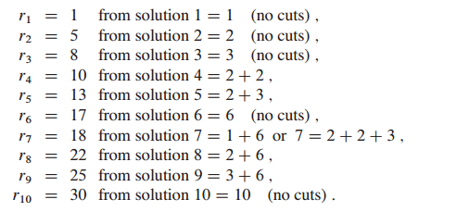
What is the overlapping sub problem from this example? –Observation-
Overlapping problem/optimal substructure
Optimal solutions to a problem incorporate optimal solutions to related subproblems, wich we may solve independently.

Slide 7
Deciding the correct recurrence -Abstraction-

Slide 8
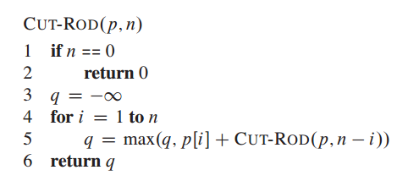
Recursive Solution

Slide 9
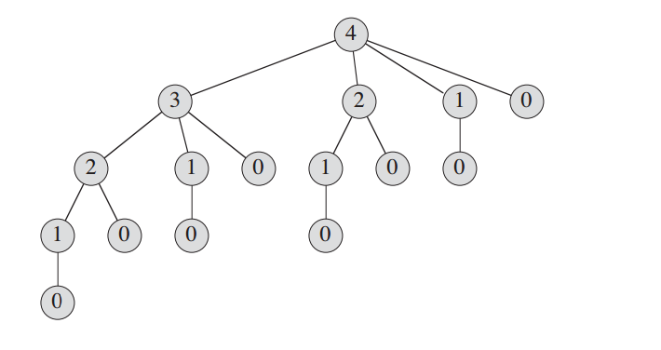
Recursion Tree

Slide 10
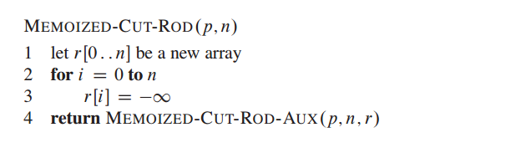
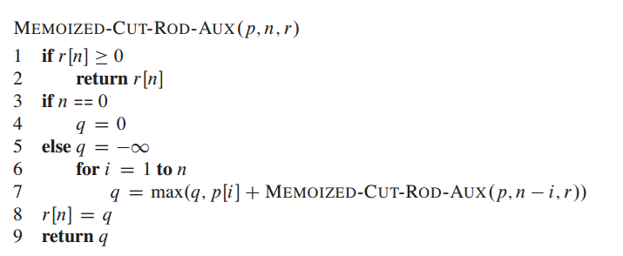
DP Top Down

Slide 11
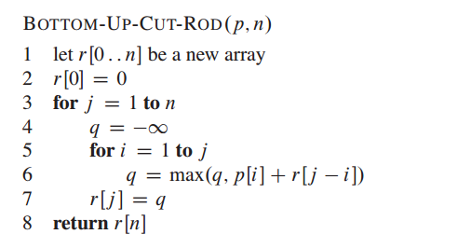
DP Bottom Up

Slide 12
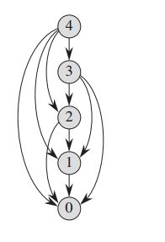
Subproblem graph
The set of subproblems involved and how subproblems depend on one another

Slide 13
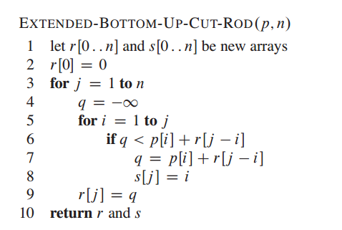
Reconstructing a solution

Slide 14
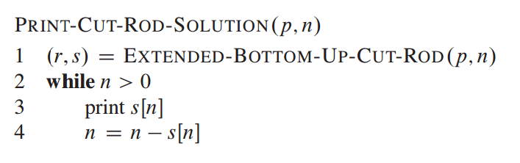
Print the solution

Slide 15
Terminology
overlapping sub problem/optimal substructure
recurrence
memo table
DP bottom up
DP top down
sub problem graphs

